Slide 1
Unit I
Data warehousing and online analytical processing

Slide 2
Data Warehouse
A Data Warehouse (DW) is a relational database that is designed for query and analysis rather than transaction processing. It includes historical data derived from transaction data from single and multiple sources.
A Data Warehouse provides integrated, enterprise-wide, historical data and focuses on providing support for decision-makers for data modeling and analysis.
A Data Warehouse is a group of data specific to the entire organization, not only to a particular group of users.
It is not used for daily operations and transaction processing but used for making decisions.

Slide 3
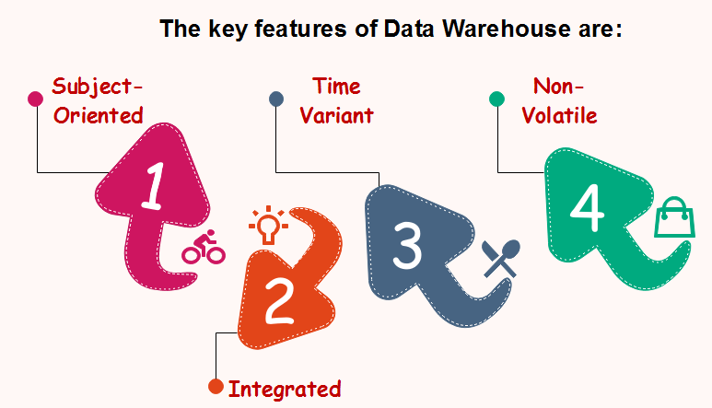
Characteristics of Data Warehouse

Slide 4
Subject-Oriented
A data warehouse target on the modeling and analysis of data for decision-makers.
Data warehouses typically provide a concise and straightforward view around a particular subject, such as customer, product, or sales, instead of the global organization's ongoing operations.

Slide 5
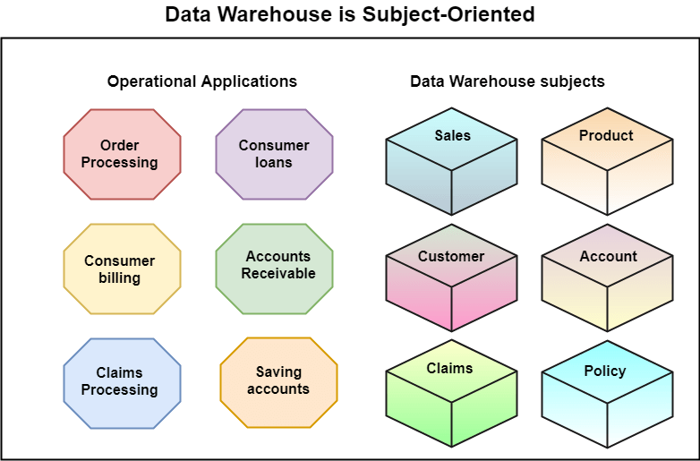

Slide 6
Integrated
A data warehouse integrates various heterogeneous data sources like RDBMS, flat files, and online transaction records.
It requires performing data cleaning and integration during data warehousing to ensure consistency in naming conventions, attributes types, etc., among different data sources.

Slide 7
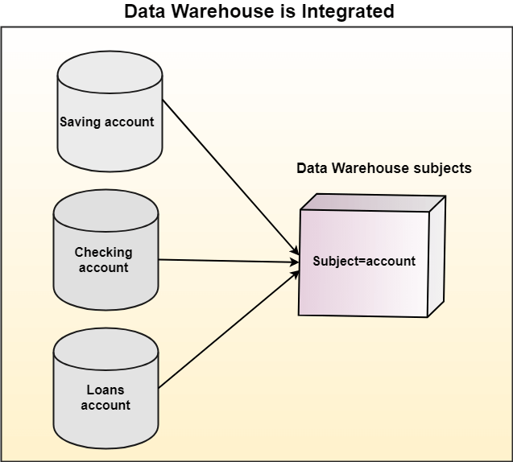

Slide 8
Time-Variant
Historical information is kept in a data warehouse. For example, one can retrieve files from 3 months, 6 months, 12 months, or even previous data from a data warehouse.
These variations with a transactions system, where often only the most current file is kept.

Slide 9


Slide 10
Non-Volatile
The data warehouse is a physically separate data storage, which is transformed from the source operational RDBMS.
The operational updates of data do not occur in the data warehouse, i.e., update, insert, and delete operations are not performed. It usually requires only two procedures in data accessing: Initial loading of data and access to data.
Non-Volatile defines that once entered into the warehouse, and data should not change.

Slide 11
